Slide 1
ANALYSIS OF BOOKING COMPLETION IN BRITISH AIRWAY
By Osaherhumwen Igbinnosa

Slide 2
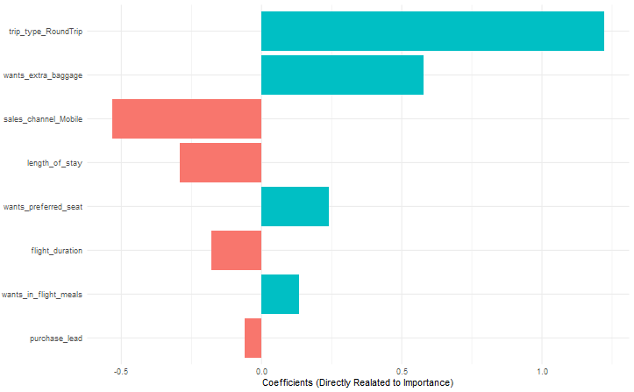
RESULTS
The main aim was to discover which factors affect completion of booking for British Airway customers
Preprocessing steps removed five un-necessary variables
A logarithmic and Random Forest model was settled on after finalization of analysis
The receiver operating characteristic area under curve was discovered to be 0.645 and 0.684 respectively
The logistic model was chosen to determine variable importance due to its invariability compared to its counterpart
Plot of variable importance ordered by the magnitude of effect in probability of completing a booking order

